Slide 1
NODE JS
Server-Side Javascript runtime environment

Slide 2
What is Node.js ?
Node.js is a JS runtime environment which allows the infrastructure to build and run an application.
It’s a light, scalable, and cross-platform way to execute code.
It uses an event-driven I/O model which makes it extremely efficient and makes scalable network application possible.
Node.js is built upon Google Chrome’s V8 runtime—written in C++, built for multiple operating systems and super fast.

Slide 3
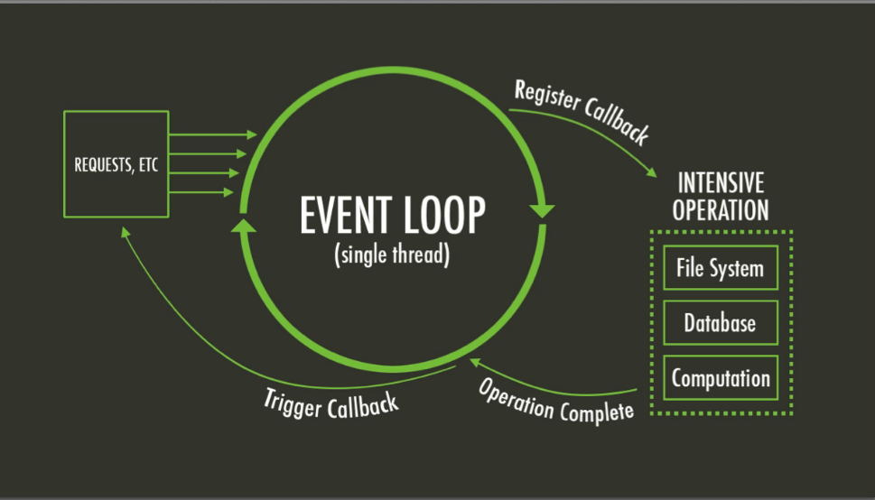
Event Loop

Slide 4
Important Advantages
It makes building real-time apps (eg. chat or gaming) lightning fast,
The ever-growing NPM (Node Package Manager) gives developers multiple tools and modules to use, thus further boosting their productivity, code executes faster than in any other language,
Node is perfect for microservices which are a popular solution among enterprise apps

Slide 5







Slide 6


Slide 7
Node.js Frameworks
Node.js is a low-level platform. In order to make things easy and exciting for developers, thousands of libraries were built upon Node.js by the community.
AdonisJs
Express
Fastify
Hapi
Koa
Loopback.io
Meteor
MicroNestJS
Next.js
Nx
Socket.io

